Slide 1

PROCESS SELECTION

Slide 2
HOUSE RULES
Close all laptops unless needed for discussion.
No use of cellphones during the discussion unless there is an emergency.
Questions can be raised during the lecture.
01
02
03

Slide 3
OBJECTIVES
01
02
03
Business will be aware of the RPA CoE Governance Model
04
Understand the concepts for an effective RPA development cycle
Comply with the CoE methodology when selecting processes for RPA
Prepare necessary documents for the Delivery and Development Phase

Slide 4
COURSE OUTLINE
01
Governance Model Overview
02
Process Selection Overview
03
Process Selection Concepts
04
Tools Orientation
05
Exam

Slide 5
COURSE OUTLINE
01
Governance Model Overview
02
Process Selection Overview
03
Process Selection Concepts
04
Tools Orientation
05
Exam

Slide 6
GOVERNANCE
MODEL
02
04
06
DISCOVERY
IMPLEMENTATION
BENEFITS
REALIZATION
Demand Management Process Definition
Delivery
Deployment
01
03
05
IDEATION
SOLUTIONING
OPERATIONS
Transition to Automation
Opportunity Selection
Demand Management (Dev)
Pre-requisite for Dev
Agile Lifecycle
Operations
Support

Slide 7
RPA CoE ORGANIZATION STRUCTURE
CoE Business
CoE Core/ISG
Head of Function
Head of RPA
Continuous Improvement Manager
Delivery Manager
Platform Manager
RPA Evangelist
Process Owner (s)
Product Owner
Scrum Master
Solution Designer
RPA SDM / DevOps Coach
Platform SDM(s)
Business Process SME (s)
Process Analyst
RPA Lead Developer
Process Analyst
Scrum Master
Infra Squad Implementation
RPA L1
DevOps Engineer
Infra Squad Ops
Developer
Tester
RPA Lead Developer
RPA Orchestrator Ops Team
Optional for business
Developer
Tester

Slide 8
IDEATION
DISCOVERY
SOLUTIONING
IMPLEMENTATION
OPERATION
DEMAND MANAGEMENT
(PROCESS)
DEMAND MANAGEMENT (DEVELOPMENT)
CAPACITY MANAGEMENT (PEOPLE)
ROBOT PACKAGE CREATION
TRANSITION TO AUTOMATION
FULFILL SERVICE REQUEST
FULFILL SERVICE REQUEST
CAPACITY MANAGEMENT (PEOPLE)
DEFINE PROCESS REQUIREMENTS
AGILE LIFECYCLE (DEV, TEST)
HANDOVER FOR DEPLOYMENT
PROCESS SELECTION
CREATION OF PDD
CAPACITY MANAGEMENT (SYSTEM)
UAT
CREATE INITIAL BUSINESS CASE
+
UPDATING OF BUSINESS CASE
REQUEST FOR ACCESSES
YES
RELEASE PACKAGE TO PRODUCTION
Approved?
NO
REQUEST FOR INFRA
MONITOR HEARTBEAT OF ROBOTS
NO
Approved?
YES
HYPERCARE PHASE

Slide 9
COURSE OUTLINE
01
Governance Model Overview
02
Process Selection Overview
03
Process Selection Concepts
04
Tools Orientation
05
Exam

Slide 10
Process Flow
IDEATION
DISCOVERY
SOLUTIONING
IMPLEMENTATION
OPERATIONS

Slide 11
PROCESS SELECTION
IMPLEMENTATION
OPERATIONS
IDEATION
DISCOVERY
SOLUTIONING
1
2
SELECT PROCESS FOR RPA
ANSWER AND SUBMIT IPA
PROCESS OWNER
3
ASSIGN PROCESS ANALYST TO THE SELECTED PROCESS
PRODUCT OWNER
4
Approved?
5
Business Case Creation
DETERMINE ELIGIBILITY FOR RPA
CALCULATE PROCESS COMPLEXITY
A
PROCESS ANALYST
Yes
No
INPUT / OUTPUT
IPA QUESTIONNAIRE
COMPLEXITY CALCULATOR

Slide 12
BUSINESS CASE CREATION
IMPLEMENTATION
OPERATIONS
IDEATION
DISCOVERY
SOLUTIONING
6
PROCESS ANALYST
CREATE INITIAL BUSINESS CASE
A
7
Acceptable?
8
Process Definition
REVIEW INITIAL BUSINESS CASE
APPROVE INITIAL BUSINESS CASE
B
Yes
FINANCIAL BOARD
No
INPUT / OUTPUT
INITIAL BUSINESS CASE
ROI CALCULATOR
INITIAL BUSINESS CASE
APPROVED

Slide 13
PDD CREATION
IMPLEMENTATION
OPERATIONS
IDEATION
DISCOVERY
SOLUTIONING
9
10
PRIORITIZE PROCESS FOR RPA
ASSIGN PROCESS ANALYST TO THE INITIATIVE
PRODUCT OWNER
B
11
13
CREATE PDD
MODIFY PDD
PROCESS ANALYST
12
No
14
REVIEW PDD
SIGN-OFF PDD
PROCESS OWNER
C
Yes
Acceptable?
INPUT / OUTPUT
INITIAL BUSINESS CASE
PDD
DEMAND MANAGEMENT TEMPLATE
INITIAL
PDD
APPROVED
FINAL

Slide 14
FINALIZE BUSINESS CASE
IMPLEMENTATION
OPERATIONS
IDEATION
DISCOVERY
SOLUTIONING
13
14
PROCESS ANALYST
UPDATE PROCESS COMPLEXITY & ROI BASED ON PDD
MODIFY BUSINESS CASE
C
15
Acceptable?
16
REVIEW BUSINESS CASE
APPROVE BUSINESS CASE
Yes
FINANCIAL BOARD
No
Transition to Solutioning
INPUT / OUTPUT
PDD
UPDATED BUSINESS CASE
FINAL
COMPLEXITY CALCULATOR
COMPLEXITY CALCULATOR
UPDATED BUSINESS CASE
APPROVED

Slide 15
Roles & Responsibilities
IDEATION
DISCOVERY
SOLUTIONING
IMPLEMENTATION
OPERATIONS

Slide 16
RACI MATRIX
IDEATION
DISCOVERY
SOLUTIONING
IMPLEMENTATION
OPERATIONS
Responsible
The team member who does the work to complete the task.
Process | Function | Process Owner (s) | RPA Evangelist | Process Analyst (s) | Head of Function | Financial Board | RPA Service Owner
Select Process for RPA | Business Group/Business Unit | R/A | C | C
Answer Initial Process Assessment Questionnaire |  | R/A | C | C
Assess RPA Eligibility |  | C/I | C/I | R/A | I
Calculate Process Complexity |  | C/I | C/I | R/A |  |  | I
Compute ROI |  | C/I |  | R/A
Create Initial Business Case |  | C/I |  | R/A | I
Approve Initial Business Case |  | I |  | C | C | R/A | I
Accountable
The person who delegates work and provides final review on a task or deliverable before it’s deemed complete.
Consulted
People who provide input on a deliverable based on the impact on their work or their domain of expertise.
Informed
People who need to be kept in the loop on the progress.

Slide 17
COURSE OUTLINE
01
Governance Model Overview
02
Process Selection Overview
03
Process Selection Phases
04
Tools Orientation
05
Exam

Slide 18

IDEATION
DISCOVERY
SOLUTIONING
IMPLEMENTATION
OPERATIONS
PROCESS SELECTION
SELECTING

Slide 19
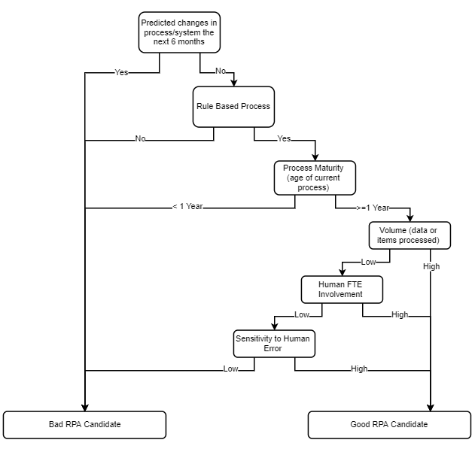
IDEATION
DISCOVERY
SOLUTIONING
IMPLEMENTATION
OPERATIONS
No changes in the process/system within the next 6 months
No human improvisation involved
Process has existed at least 1 year
FTE saved should justify the license cost

Slide 20

IDEATION
DISCOVERY
SOLUTIONING
IMPLEMENTATION
OPERATIONS
PROCESS SELECTION
GATHERING

Slide 21
IDEATION
DISCOVERY
SOLUTIONING
IMPLEMENTATION
OPERATIONS
PROGRAMS INVOLVED IN THE PROCESS
DATA BEING PROCESSED
01
Applications
02
Input Data
TYPES OF APPLICATION
ACCESS TYPE
TYPES OF DATA
NUMBER OF DATA POINTS
BASICS FOR PROCESS SELECTION

Slide 22





5 Types of Application
Web Application
Applications that are accessed via browser
Microsoft System Application
Non-Microsoft System Application
Desktop applications created by microsoft
Desktop applications not created by microsoft
SAP
Mainframe
Applications created by SAP
Applications that do not have mouse movement

Slide 23
IDEATION
DISCOVERY
SOLUTIONING
IMPLEMENTATION
OPERATIONS
PROGRAMS INVOLVED IN THE PROCESS
DATA BEING PROCESSED
01
Applications
02
Input Data
SYSTEM APPLICATION (MICROSOFT)
SYSTEM APPLICATION (NON-MICROSOFT)
WEB APPLICATION
SAP
MAINFRAME
TYPES OF DATA
NUMBER OF DATA POINTS
BASIC INFORMATION FOR PROCESS SELECTION

Slide 24
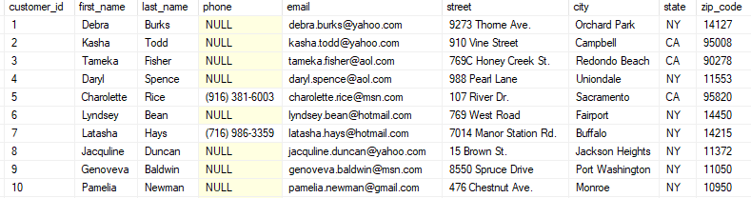
4 Types of Input Data
Standard
Data is located at a specific location and does not need logic to locate.
1
Getting data from the first column will always result in getting the customer ID

Slide 25
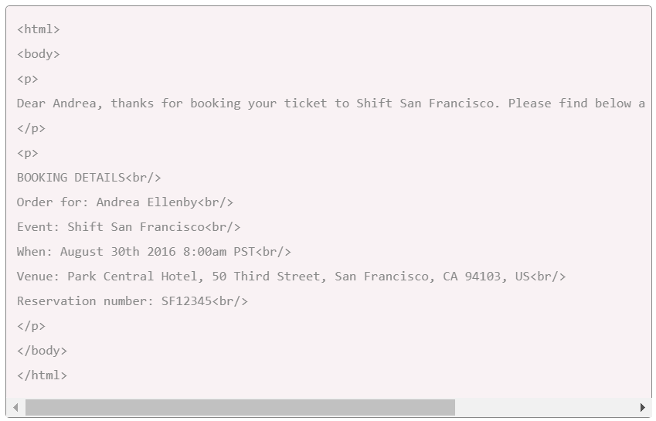
4 Types of Input Data
Structured Free Text
2
Data is located at a specific location but needs simple logic to locate.
Getting the customer name from the email will need logic to look for the text after the “Order for: “

Slide 26
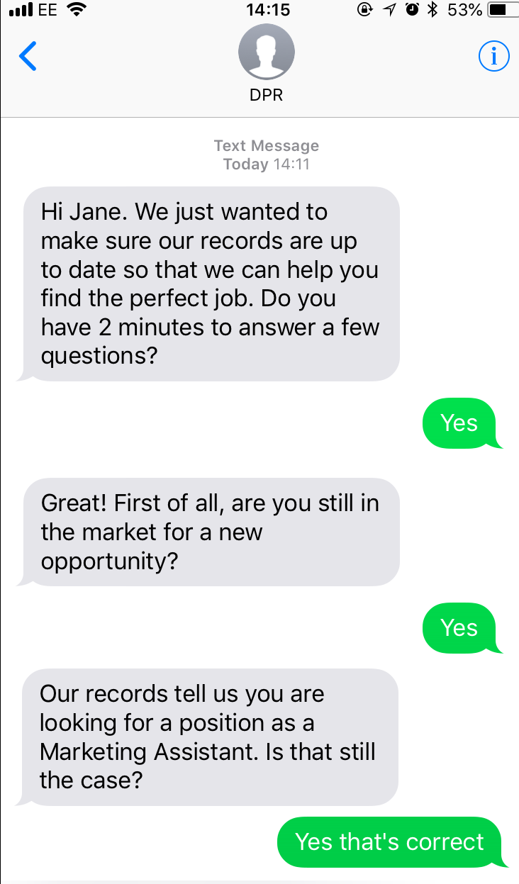
4 Types of Input Data
Unstructured Free Text
Data is not located at a specific location and will need complex logic to locate.
3

Slide 27
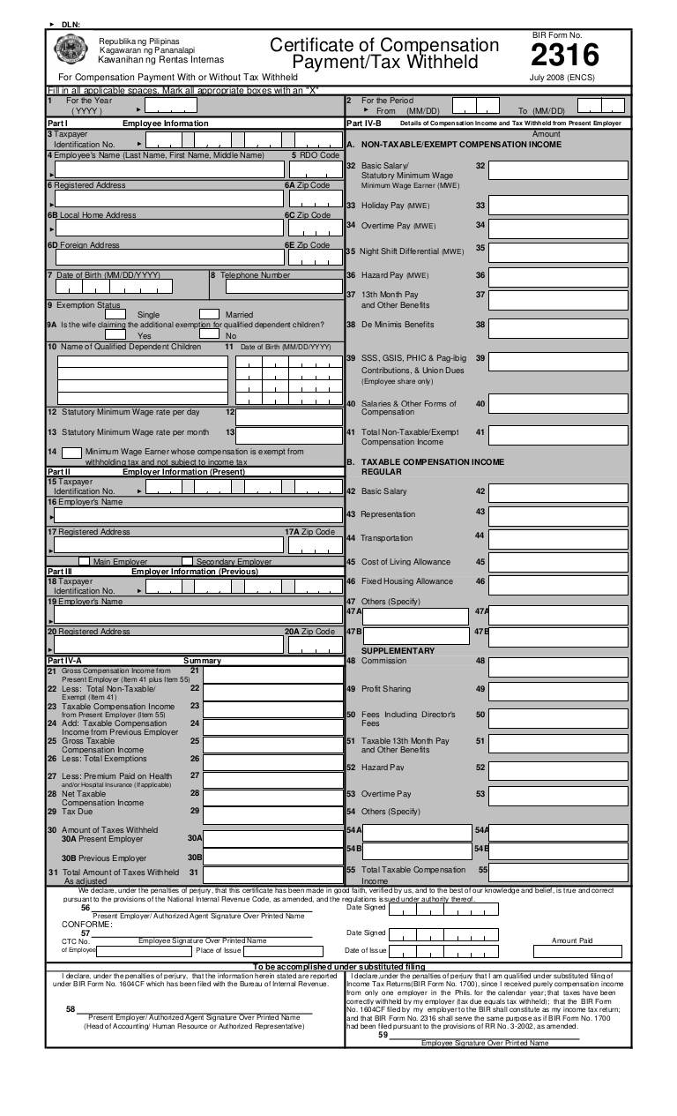
4 Types of Input Data
This will need an image recognition software in order to import the data from this picture.
Pictures
4
Data is in an image format and will need an image recognition software to read. The imported data will be considered as free text.

Slide 28
4 Types of Input Data
Standard
Structured Free Text
Data is located at a specific location and does not need logic to locate.
1
2
Data is located at a specific location but needs simple logic to locate.
Unstructured Free Text
Pictures
Data is not located at a specific location and will need complex logic to locate.
3
4
Data is in an image format and will need an image recognition software to read.

Slide 29
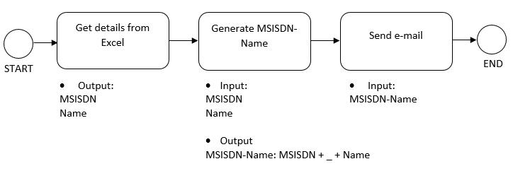
Counting Input Data
Source
Processing
Input data is data from a source that needs processing to generate an output.
Input Data

Slide 30
IDEATION
DISCOVERY
SOLUTIONING
IMPLEMENTATION
OPERATIONS
DEGREE OF DIFFICULTY TO AUTOMATE A PROCESS
DETAILS OF THE PROCESS
03
04
Operational Information
RPA Score
COMPLEXITY
EFFORT
OTHER FACTORS
OPERATING HOURS
FREQUENCY
SEVICE LEVEL AGREEMENT
MANHOURS
VOLUME
BASIC INFORMATION FOR PROCESS SELECTION
Notes:
Complexity – logic difficulty
Effort – coding difficulty
Other Factors – Remote Access

Slide 31
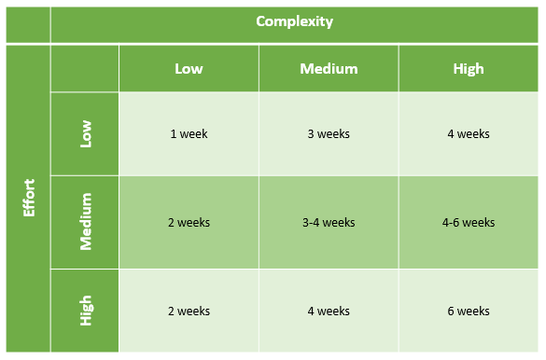
Complexity Matrix
This will determine the development days needed for the process

Slide 32
IDEATION
DISCOVERY
SOLUTIONING
IMPLEMENTATION
OPERATIONS
DEGREE OF DIFFICULTY TO AUTOMATE A PROCESS
DETAILS OF THE PROCESS
03
04
Operational Information
RPA Score
COMPLEXITY
EFFORT
OTHER FACTORS
OPERATING HOURS
FREQUENCY
SEVICE LEVEL AGREEMENT
MANHOURS
VOLUME
HANDLE DURATION
SERVICE LEVEL AGREEMENT
BASIC INFORMATION FOR PROCESS SELECTION
Notes:
Operational Information is important in order to determine the following:
Type of license needed for the process
Number of licenses needed for the process

Slide 33


Type of Licenses
Attended
Unattended

Slide 34
Attended Robots
Pros:
Cheaper
Cons:
Needs human intervention
Cannot be scheduled
When to Use:
Processes that have human approval checkpoints
Tools for customer support
Task specific automation

Slide 35
Unattended Robots
Pros:
Able to run on a 24x7x365 basis
Real time monitoring
Self-triggered (time based/ event based)
Cons:
More expensive
When to use:
Continuous process that does not have human check points
Heavy back office activities
End to end process automation
Notes:
Schedule can either be time based or events based

Slide 36
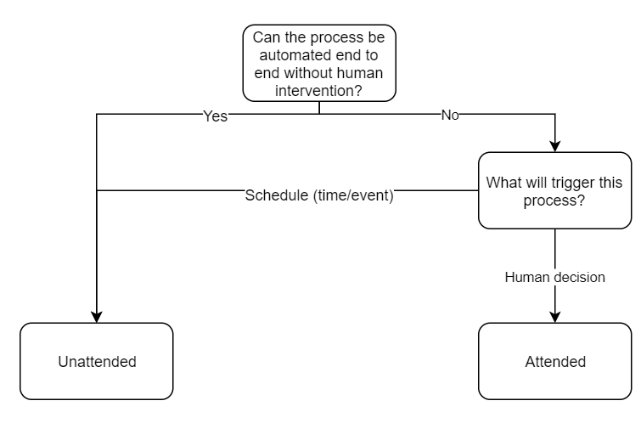
Choosing the Type of Licenses

Slide 37



Number of Licenses
$$Number of Robot Licenses = \frac{FTE × Work Hours per Day}{24}$$
Notes:
Round-up the licenses for the worst case scenario

Slide 38
IDEATION
DISCOVERY
SOLUTIONING
IMPLEMENTATION
OPERATIONS
MEASURES OF THE PROCESS
END
05
ERRORS
ERROR VOLUME
ERROR PERCENTAGE
ERROR HANDLING
BASIC INFORMATION FOR PROCESS SELECTION
Notes:
Knowing the number of errors and how it is being handled will determine if a process needs improvement outside of RPA
While existing methods of error handling must be define in order to be part of the logic used by the robot

Slide 39
IDEATION
DISCOVERY
SOLUTIONING
IMPLEMENTATION
OPERATIONS
MEASURES OF THE PROCESS
END
05
ERRORS
HANDLE DURATION
SERVICE LEVEL AGREEMENT
BASIC INFORMATION FOR PROCESS SELECTION

Slide 40

IDEATION
DISCOVERY
SOLUTIONING
IMPLEMENTATION
OPERATIONS
PROCESS SELECTION
ASSESSING

Slide 41
IDEATION
DISCOVERY
SOLUTIONING
IMPLEMENTATION
OPERATIONS
01
02
03
Determine eligibility of process for RPA
Determine process complexity
Determine ROI of initiative

Slide 42
IDEATION
DISCOVERY
SOLUTIONING
IMPLEMENTATION
OPERATIONS
01
Determine eligibility of process for RPA

Slide 43

IDEATION
DISCOVERY
SOLUTIONING
IMPLEMENTATION
OPERATIONS
02
This will contribute to the logic needed for the robot
Application types will have varying complexity level when coding
Data Input Type
The more free text input data involved, the more complex logic needed
Types of Applications
Determine process complexity
Percentage Free Text
The more application involved, the higher effort needed to code
This will need image recognition software
Number of Applications
Remote Access

Slide 44
IDEATION
DISCOVERY
SOLUTIONING
IMPLEMENTATION
OPERATIONS
03
One-time Benefit
ROI
Investment Cost
Determine ROI of initiative
Recurring Benefit
Recurring Cost

Slide 45
IDEATION
DISCOVERY
SOLUTIONING
IMPLEMENTATION
OPERATIONS
Increased Revenue
Risk Avoidance Savings
Testing Cost
Development Cost
FTE Savings
Infrastructure Cost
License Cost
Maintenance

Slide 46

IDEATION
DISCOVERY
SOLUTIONING
IMPLEMENTATION
OPERATIONS
PROCESS SELECTION
DOCUMENTING

Slide 47
BUILDING YOUR BUSINESS CASE
IDEATION
DISCOVERY
SOLUTIONING
IMPLEMENTATION
OPERATIONS
Approval
Cost
Objectives
ROI
Savings

Slide 48
COURSE OUTLINE
01
Governance Model Overview
02
Process Selection Overview
03
Process Selection Concepts
04
Tools Orientation
05
Exam

Slide 49
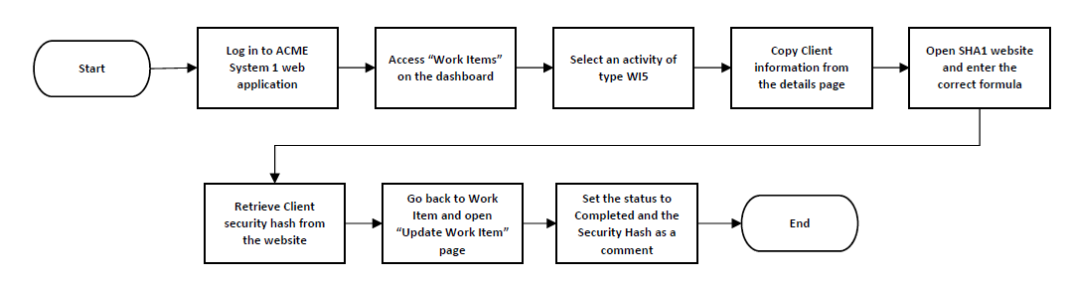
Sample Case
The security team which consists of 1 business user is designated to generate security hash from 8AM to 5PM every Monday to Friday for each client based on their personal information. The number of items being processed per day is 7-15 clients. The average handling time per item without exception is 2 minutes per client. The amount of transaction requests coming in daily is 11. The input data will be the client data and its expected output is the client security hash. This process will be 100% automated. The team has an SLA of 4 minutes completion of processing per client. Possible errors in running the process are incorrect email or password, no existing WI5 task and unresponsive application. These errors are being encountered twice daily.

Slide 50


INITIAL PROCESS ASSESSMENT(IPA) QUESTIONNAIRE

Slide 51
Let’s know more about your selected process
Question | Answer
What is the name of your nominated RPA process? | Calculate Client Security Hash
Give a brief overview of the process. | Generate the Security Hash for each Client based on their personal information
What applications/platforms are being used by the agent in this process? | ACME System 1 web application SHA1 Online webpage
How many times does the “screen” switch when executing the whole process? (Count of screen changes across the whole process.) | 9
Does the agent need remote access (e.g. Citrix) to execute this process? | No
Does any of the steps in executing this process have RPA involved? | No

Slide 52
What kind of information are you handling in this process?
Question | Answer
How many input data, regardless if it’s standard or free text, does the process have? | 2
Are there any free texts (structured/unstructured) information involved in this process? | Yes
If yes, where do unstructured information come from? | ACME System 1 web application
Are there any scanned documents/images involved in order for the agent to execute this process? | No
What is the expected output of this process? | Update the client security hash of the work items

Slide 53
Let’s know more about what you do.
Question | Answer
How long has this process existed? | 1 year
What are the operating hours for the execution of this process? | 8AM – 5PM
How often is this process executed? | Daily
How many total man hours are needed to execute this process? | 1 FTE = 8 hours
What’s the average amount of transaction requests coming in for this process? | 11

Slide 54
Let’s know more about what you do.
Question | Answer
What’s the highest amount of transaction requests coming in for this process? | 15
What is the average handling duration per transaction/item for the execution of this process? (i.e. In minutes) | 2 minutes/client
What is the Service Level Agreement (SLA) per transaction/item for the execution of this process? (i.e. in minutes) | 4 minutes
Is the business process or system expected to change or be changed within the next 6 months? | No

Slide 55
What difficulties do you encounter?
Question | Answer
What errors do the agent encounter when executing this process? | Application unresponsive / page not loading Incorrect email or password No task of type WI5 exists
How often does the agent encounter these errors when executing this process? | Daily
How many times does the agent encounter these errors? (e.g. twice daily, once weekly, etc.) | Twice daily

Slide 56

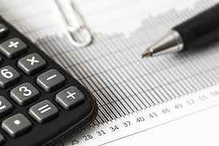
COMPLEXITY CALCULATOR

Slide 57
What is the name of the process?
Enter Details Here
Process Name
Standard Input
Free Text
Is there more than 1 application involved?
Number of Screens
Citrix
OCR
Complexity %
Complexity
Effort

Slide 58
What is the name of the process?
Enter Details Here
Process Name | Calculate Client Security Hash
Standard Input
Free Text
Is there more than 1 application involved?
Number of Screens
Citrix
OCR
Complexity %
Complexity
Effort

Slide 59
What % of the data input is free text?
Enter Details Here
Process Name | Calculate Client Security Hash
Standard Input
Free Text
Is there more than 1 application involved?
Number of Screens
Citrix
OCR
Complexity %
Complexity
Effort

Slide 60
What % of the data input is free text?
Enter Details Here
Process Name | Calculate Client Security Hash
Standard Input | No
Free Text | 100%
Is there more than 1 application involved?
Number of Screens
Citrix
OCR
Complexity %
Complexity
Effort
If there’s any free text available in the process, this becomes “No”

Slide 61
Are there more than 1 application involved in the process?
Enter Details Here
Process Name | Calculate Client Security Hash
Standard Input | No
Free Text | 100%
Is there more than 1 application involved?
Number of Screens
Citrix
OCR
Complexity %
Complexity
Effort

Slide 62
What are type of applications are involved in the process?
Enter Details Here
Process Name | Calculate Client Security Hash
Standard Input | No
Free Text | 100%
Are there more than 1 application involved? | Yes
System Application (Microsoft)
System Application (Non-Microsoft)
Web Application
SAP
Mainframe
Number of Screens
Citrix
OCR
Complexity %
Complexity
Effort
By answering “Yes”, you’ll be asked to input the number of applications involved per type

Slide 63
What are type of applications are involved in the process?
Enter Details Here
Process Name | Calculate Client Security Hash
Standard Input | No
Free Text | 100%
Are there more than 1 application involved? | Yes
System Application (Microsoft)
System Application (Non-Microsoft)
Web Application | 2
SAP
Mainframe
Number of Screens
Citrix
OCR
Complexity %
Complexity
Effort

Slide 64
How many number of screens does the process have?
Enter Details Here
Process Name | Calculate Client Security Hash
Standard Input | No
Free Text | 100%
Are there more than 1 application involved? | Yes
System Application (Microsoft)
System Application (Non-Microsoft)
Web Application | 2
SAP
Mainframe
Number of Screens
Citrix
OCR
Complexity %
Complexity
Effort

Slide 65
How many number of screens does the process have?
Enter Details Here
Process Name | Calculate Client Security Hash
Standard Input | No
Free Text | 100%
Are there more than 1 application involved? | Yes
System Application (Microsoft)
System Application (Non-Microsoft)
Web Application | 2
SAP
Mainframe
Number of Screens | 0 – 10
Citrix
OCR
Complexity %
Complexity
Effort

Slide 66
Does this process need Citrix (remote access)?
Enter Details Here
Process Name | Calculate Client Security Hash
Standard Input | No
Free Text | 100%
Are there more than 1 application involved? | Yes
System Application (Microsoft)
System Application (Non-Microsoft)
Web Application | 2
SAP
Mainframe
Number of Screens | 0 – 10
Citrix
OCR
Complexity %
Complexity
Effort

Slide 67
Does this process need Citrix (remote access)?
Enter Details Here
Process Name | Calculate Client Security Hash
Standard Input | No
Free Text | 100%
Are there more than 1 application involved? | Yes
System Application (Microsoft)
System Application (Non-Microsoft)
Web Application | 2
SAP
Mainframe
Number of Screens | 0 – 10
Citrix | No
OCR
Complexity %
Complexity
Effort

Slide 68
Does this process need OCR (image recognition software)?
Enter Details Here
Process Name | Calculate Client Security Hash
Standard Input | No
Free Text | 100%
Are there more than 1 application involved? | Yes
System Application (Microsoft)
System Application (Non-Microsoft)
Web Application | 2
SAP
Mainframe
Number of Screens | 0 – 10
Citrix | No
OCR
Complexity %
Complexity
Effort

Slide 69
Does this process need OCR (image recognition software)?
Enter Details Here
Process Name | Calculate Client Security Hash
Standard Input | No
Free Text | 100%
Are there more than 1 application involved? | Yes
System Application (Microsoft)
System Application (Non-Microsoft)
Web Application | 2
SAP
Mainframe
Number of Screens | 0 – 10
Citrix | No
OCR | No
Complexity %
Complexity
Effort

Slide 70
How complex is the process?
Enter Details Here
Process Name | Calculate Client Security Hash
Standard Input | No
Free Text | 100%
Are there more than 1 application involved? | Yes
System Application (Microsoft)
System Application (Non-Microsoft)
Web Application | 2
SAP
Mainframe
Number of Screens | 0 – 10
Citrix | No
OCR
Complexity % | 32.00%
Complexity | Medium
Effort | Low
After completing the inputs for the parameters above, the Complexity and Effort will be automatically computed. Now, match this to the complexity matrix to get the development days needed

Slide 71


ROI CALCULATOR

Slide 72
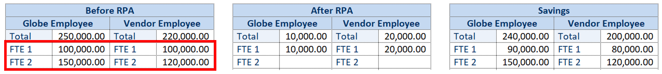
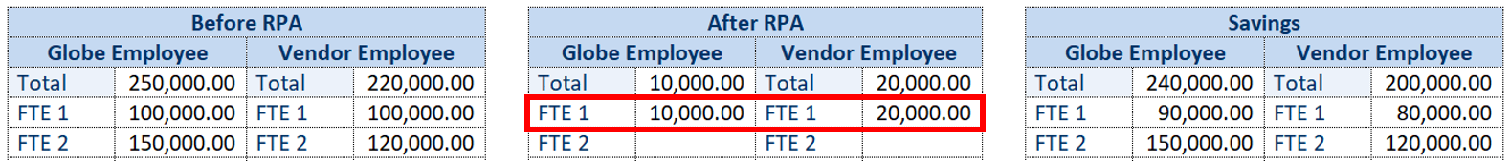
How do we use the calculator?
Go to ROI Calculator file
On “Savings” sheet, enter the annual costs for both Globe Employee and Vendoer Employee before the implementation of RPA. The cost should be based on the time spent doing the process/task.
enter the annual costs for both Globe Employee and Vendoer Employee after the implementation of RPA. The cost should be based on the time spent doing the process/task.

Slide 73
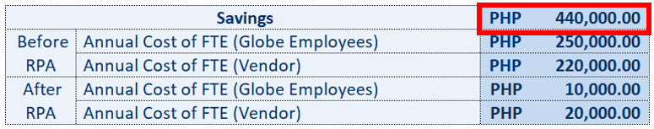
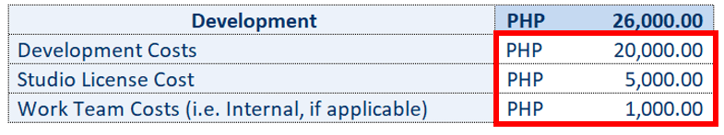
How do we use the calculator?
Both internal and external FTE savings will be computed.
On “Development” sheet, enter the development and work team costs. This should be aligned with the providers.

Slide 74
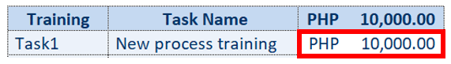
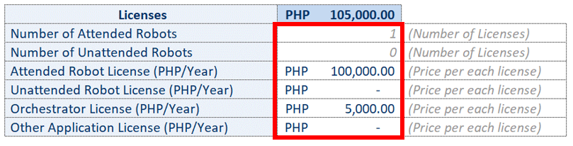
How do we use the calculator?
On "Training" sheet, enter the training cost. These are necessary trainings due to changes in the process.
Go to the "Licenses" sheet, and enter the number of robots and annual license cost. Number of license should be based on the formula set in the guidelines.

Slide 75
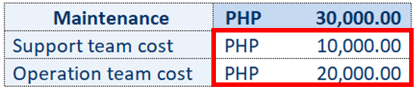
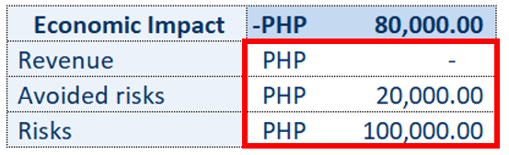
How do we use the calculator?
Go to the "Maintenance" sheet, and enter the maintenance cost. (standardized costs from the respective department)
Go to the "Economic Impact" sheet, and enter the revenue, avoided risks and risks, if any.

Slide 76
How do we use the calculator?
 | ROI (payback period, in months of a year)
 | Savings | PHP -
 | Annual Cost of FTE before RPA (Globe Employees) | PHP -
 | Annual Cost of FTE before RPA (Vendor) | PHP -
 | Annual Cost of FTE after RPA (Globe Employees) | PHP -
 | Annual Cost of FTE after RPA (Vendor) | PHP -
 | Cost Development | PHP -
 | Development Costs | PHP -
 | Studio License Cost
 | Work Team Costs (i.e. Internal, if applicable) | PHP -
 | Cost Training | PHP -
 | Cost Licences | PHP -
 | Number of Attended Robots | 0
 | Number of Unattended Robots | 0
 | Attended Robot Licence (PHP/Year) | PHP -
 | Unattended Robot Licence (PHP/Year) | PHP -
 | Orchestrator License (PHP/Year) | PHP -
 | Other License (PHP/Year) | PHP -
 | Cost Maintenance | PHP -
 | Economic Impact | PHP -
 | Revenue | PHP -
 | Avoided Risks | PHP -
 | Risks | PHP -
On "ROI" sheet, the ROI will be computed based on the savings, costs and economic impact.

Slide 77


BUSINESS CASE TEMPLATE

Slide 78
Documenting the initiative
Business Case
Process Information
Process Name: Calculate Client Security Hash
Business Unit Name: Security
Savings: <Insert info here>
Economic Impact: <Insert info here>
Investment Cost: <Insert info here>
Operational Cost: <Insert info here>
Complexity Level: <Insert info here>
Return on Investment: <Insert info here>
Business Objectives
➢ Deliver faster processing ➢ Reduce redundant activities ➢ Improve overall performance and reliability
Signature
Approver
Financial Board
Date
Comments

Slide 79


